Slide 1
ENSE 470: Milestone 6
Team Dancing to Zebras
Tristan Heisler, Demitri Kourles and Zuoxiu Xing
March 29th, 2018

Slide 2
Executive Summary - Technology
What technology did we use?
Technology | Purpose
MySQL | Data storage
HTML | Base structure of webpages
CSS | Website appearance
JavaScript | Client-side interactions
PHP | Server-side processing
GitHub | Revision control
WhatsApp | Efficient group communication
Google Docs | Improvement of collaboration on documentation files

Slide 3
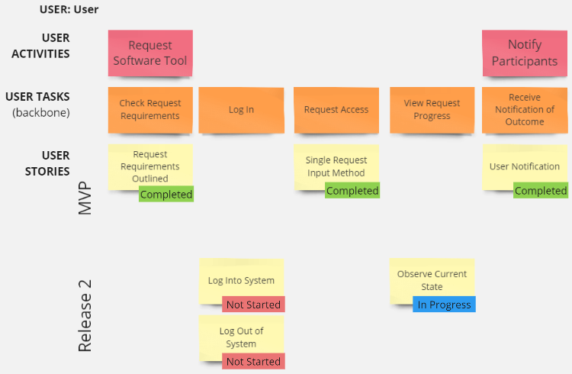
Executive Summary: USM (User)

Slide 4
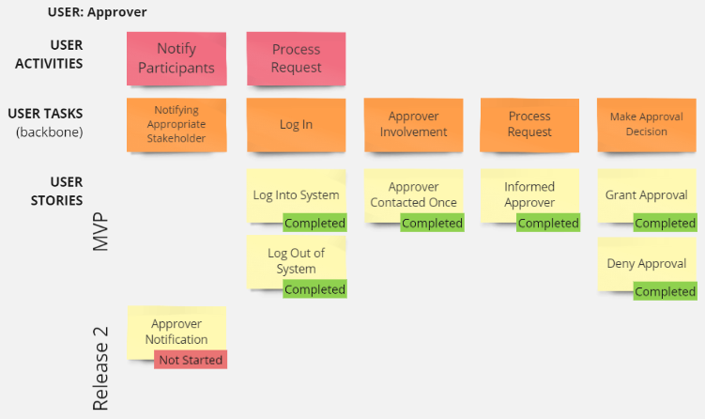
Executive Summary: USM (Approver)

Slide 5
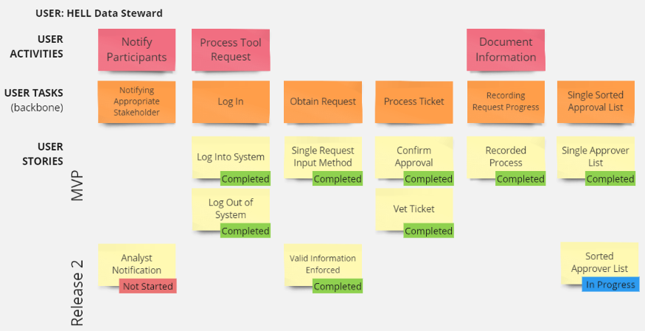
Executive Summary: USM (Analyst)

Slide 6
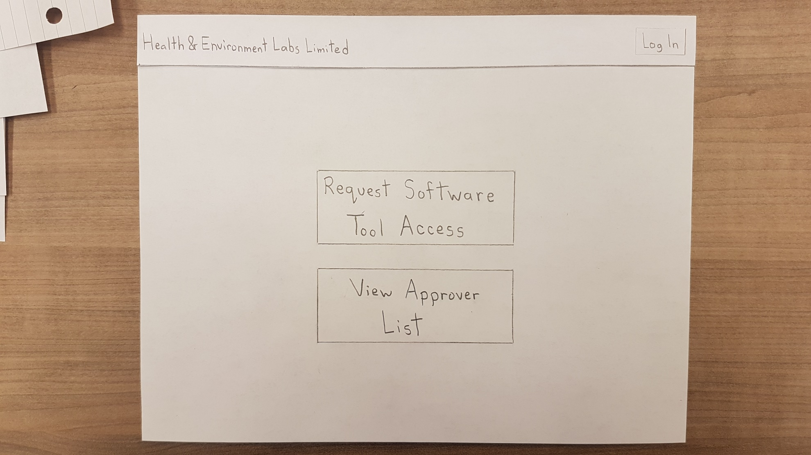
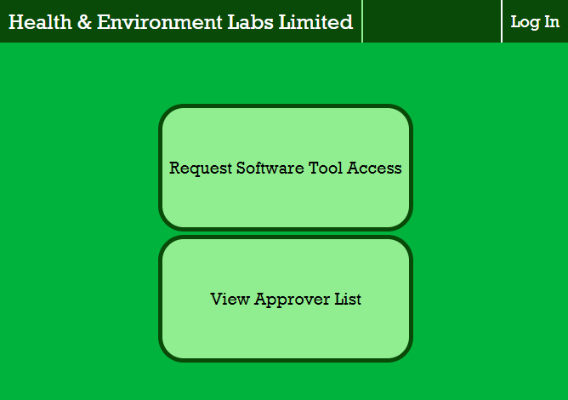
Executive Summary: Lo-Fi Overview

Slide 7
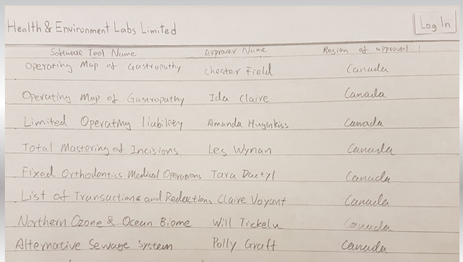
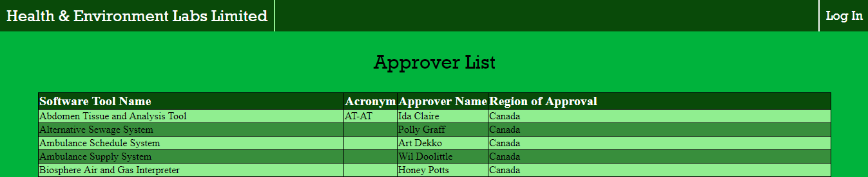
Executive Summary: Lo-Fi Overview

Slide 8
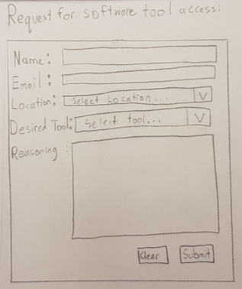
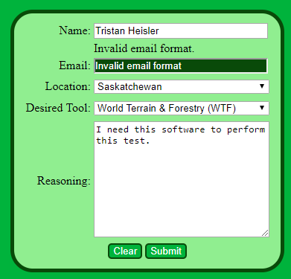
Executive Summary: Lo-Fi Overview

Slide 9
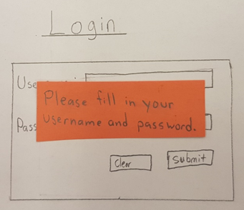
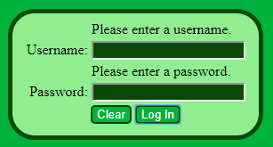
Executive Summary: Lo-Fi Overview

Slide 10
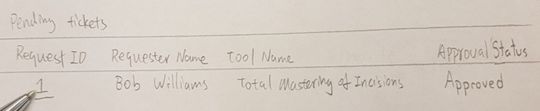
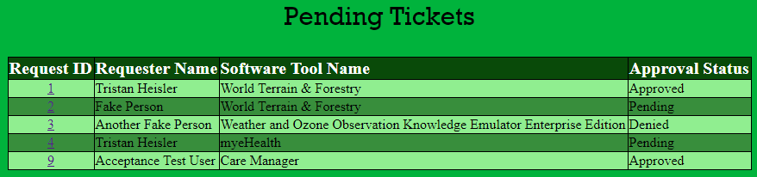
Executive Summary: Lo-Fi Overview

Slide 11
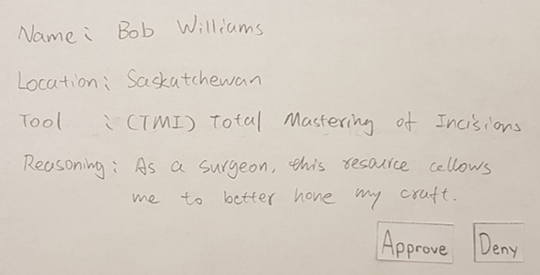
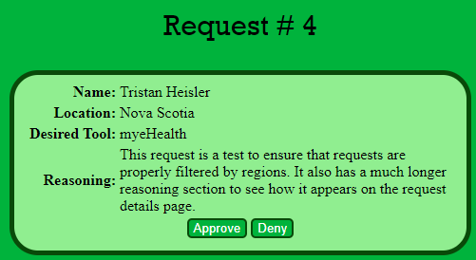
Executive Summary: Lo-Fi Overview

Slide 12
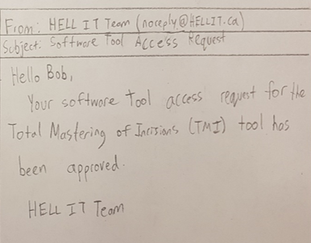
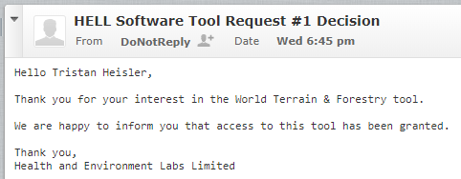
Executive Summary: Lo-Fi Overview

Slide 13
Demo
http://149.56.46.194/Team-Dancing-To-Zebras/index.php

Slide 14
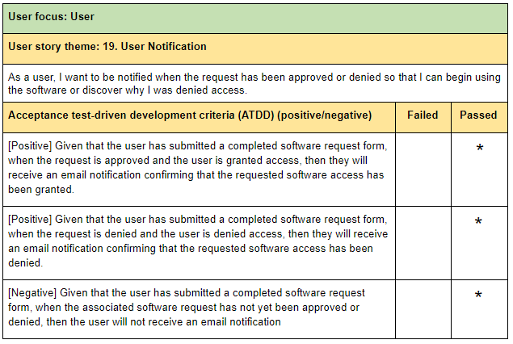
ATDD Test Case Validations

Slide 15
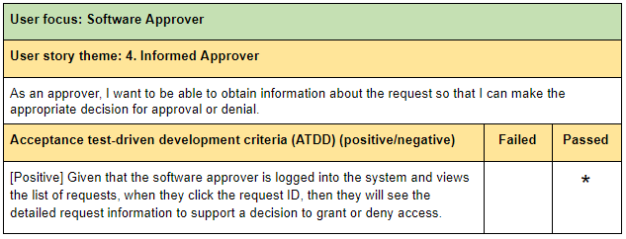
ATDD Test Case Validations

Slide 16
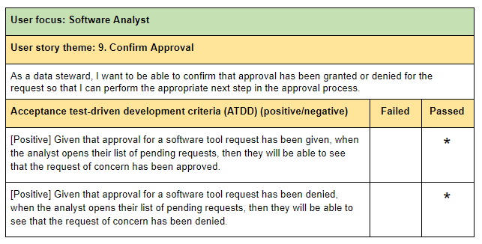
ATDD Test Case Validations

Slide 17
Design Patterns - Facade
Where?
This pattern was applied towards the navigation bar and web page access.
Why?
Different users interacting with the software tool request system have varying requirements and expectations.
How?
Web pages that are irrelevant to the current user are hidden from view. Access is denied if users attempt to access these pages manually.

Slide 18
Design Patterns - Decorator
Where?
This pattern was applied towards the navigation bar options.
Why?
To prevent having to create all possible combinations of navigation bar functionalities.
How?
Upon login, a session variable records if the user is an approver and/or an analyst. This information is used to provide additional options in the navigation bar if such a user is detected.

Slide 19
Design Patterns - State
Where?
This pattern was applied to document the status of a request and permit different permissions based on this status.
Why?
By encapsulating the state of the request, we have reduced the likelihood of invalid actions being performed throughout the request process.
How?
Each request is associated with approval status and access status variables. The approval status value influences the analyst’s interactions with the request. The access status value influence’s when the user is notified via email.

Slide 20
Design Patterns - Composite
Where?
This pattern was applied within the webpages that display pending approvals for approvers and pending tickets for analysts.
Why?
To display a clear hierarchy level that allows the employee to easily obtain information relevant to their specific request of interest.
How?
Within these pages, the user can see a general overview of all active tickets. Clicking the ID of one of these tickets transfers the user to a leaf page of the website that provides more detailed information about that request.

Slide 21
Design Patterns - Observer
Where?
This pattern was applied within the email notification system of the website.
Why?
To prevent the user from having to manually check when their ticket has been processed.
How?
When the analyst makes their final decision on a given software request, the user will immediately be notified via email of the outcome.

Slide 22
Group Reflection
How did you feel about this milestone? What did you like about it? What did you dislike?
We enjoyed being able to finally implement the system that we have been working on for several months based on our prototypes and documentation.
What did you learn about yourself as you collaborated and worked through this milestone?
By completing the minimum viable product, we developed a further appreciation for the process and steps utilized before any code was actually written.
How will you use what you have learned going forward?
In the future, we will use the successes and hurdles identified within the development of this project when developing more complex software systems.
What “stuff & things” related to this milestone would you want help with?
It was slightly challenging understanding how to apply design patterns to web development.

Slide 23
Project Experience
The good.
We exceeded our expectations for the MVP. This success would allow features from a theoretical Release 3 to be implemented ahead of schedule.
There were no major issues between group members. All members communicated quickly and contributed to the project’s development.
The bad.
We faced difficulties implementing design patterns in our website.
We believe that more practice would allow us to reduce the amount of time spent generating supporting documents like idea sheets and lo-fi prototypes.
The ugly.
Code duplication exists between several of our webpages. This is partially due to the time constraints of the project.
Manipulating over 40 pictures for our lo-fi prototypes was quite tedious.

Slide 24
Questions?

